Slide 1
FoodSquare

Slide 2
Entity Relationship Diagram

Slide 3
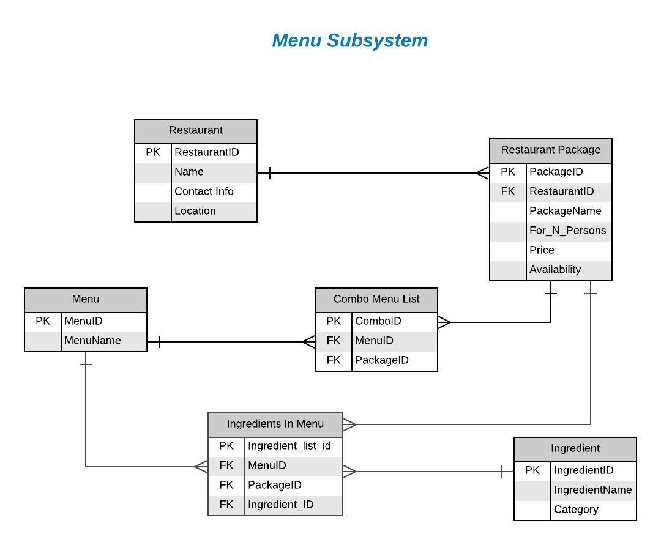

Slide 4
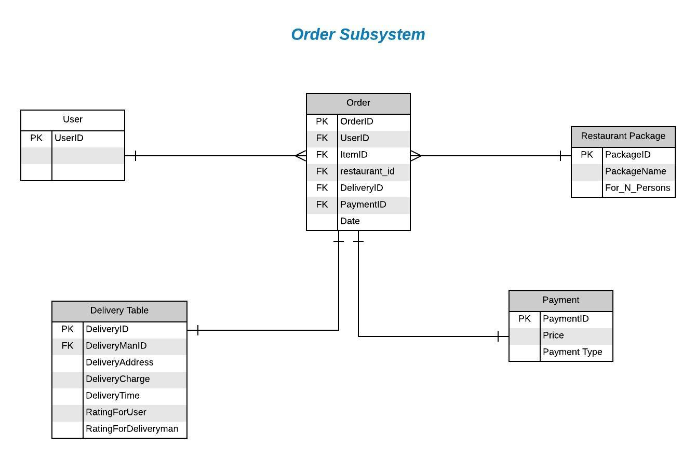

Slide 5
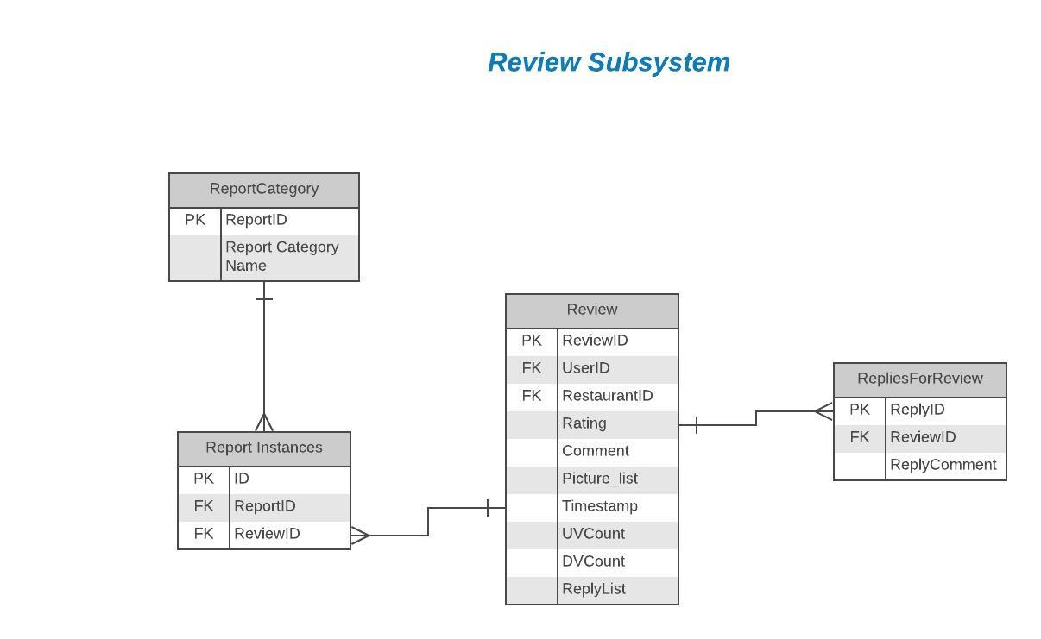

Slide 6
UML Class Diagram

Slide 7
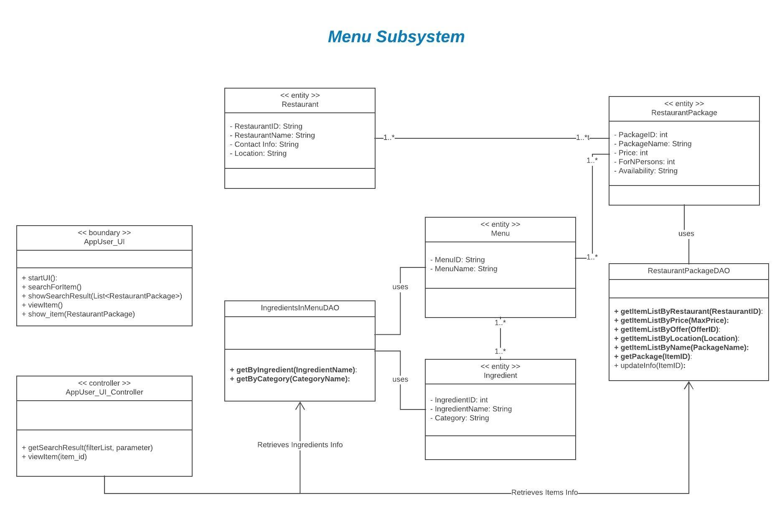

Slide 8
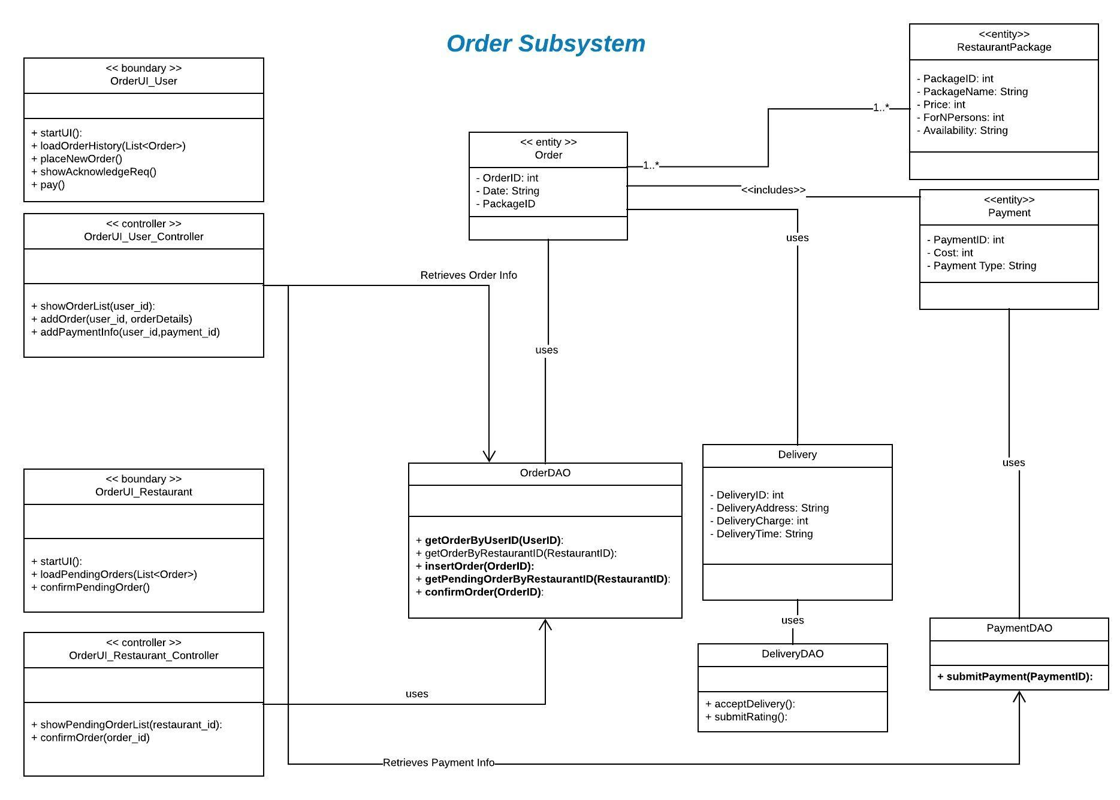

Slide 9
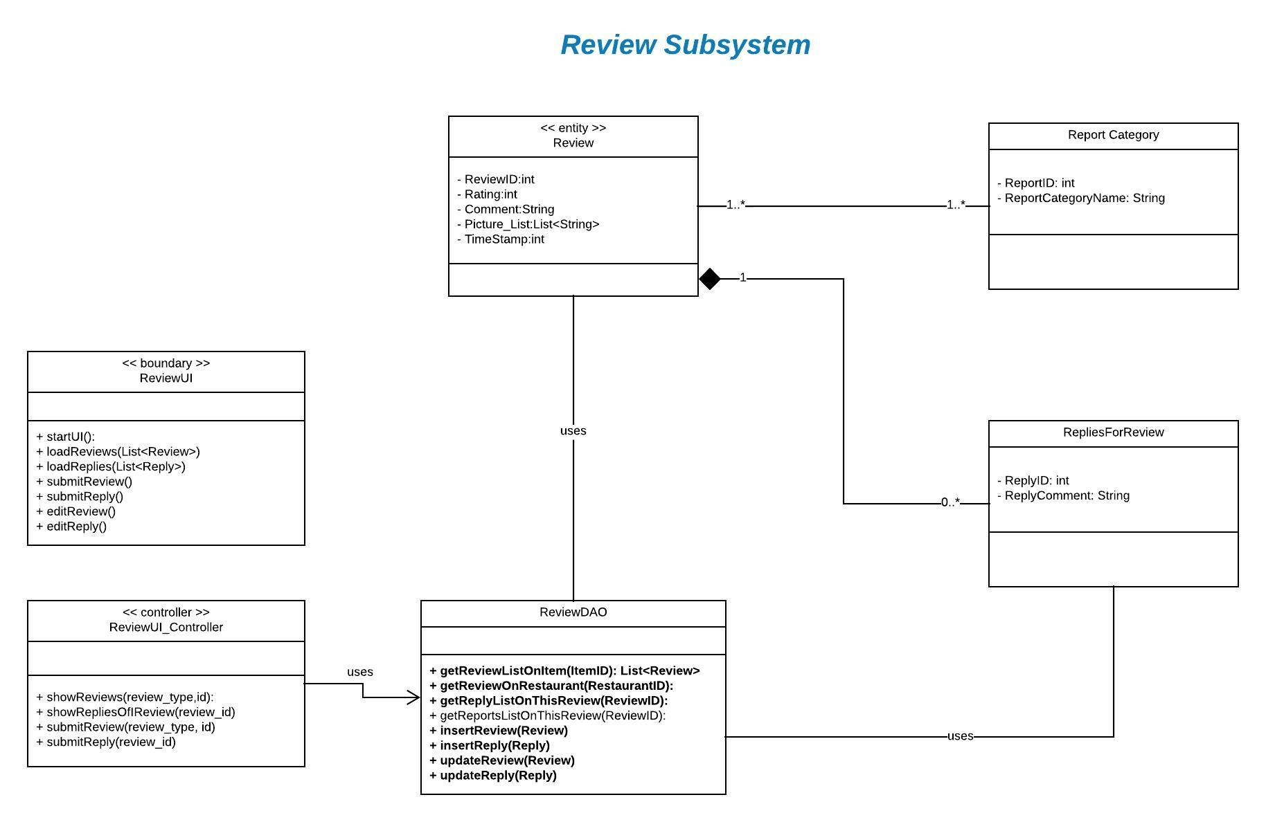

Slide 10
Thank You

